Slide 1
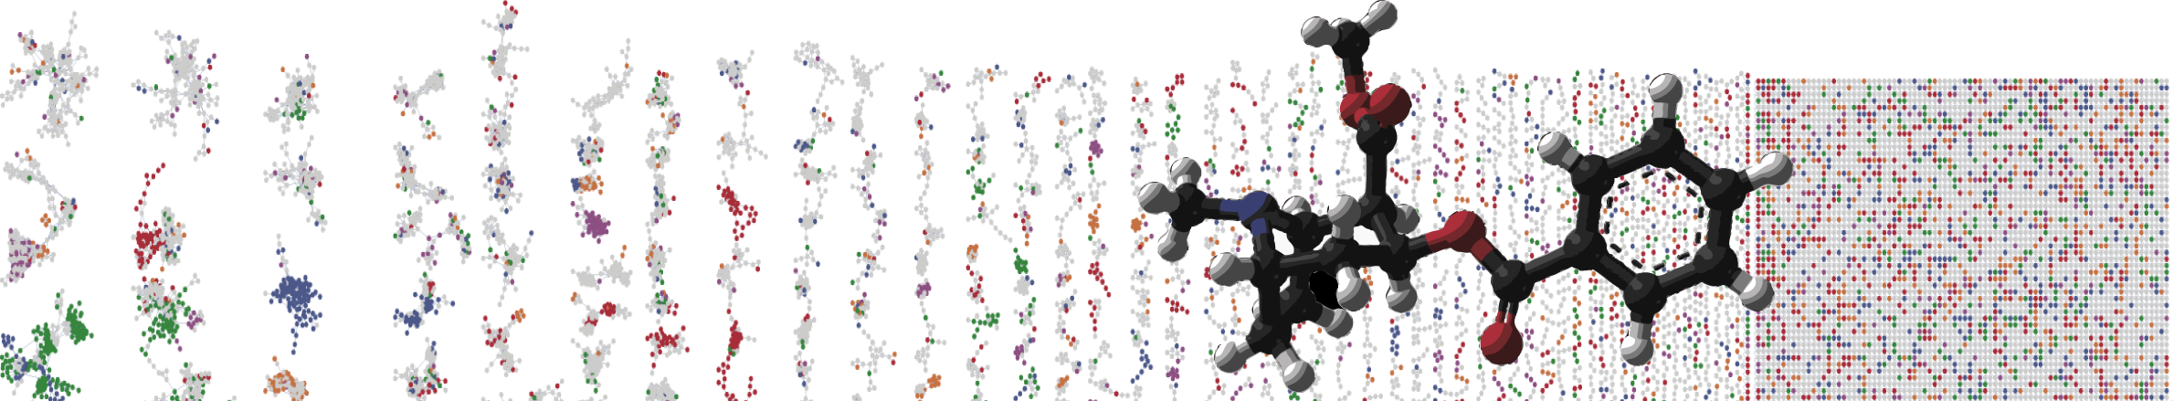


GNPS – LCMS Dashboard
HANDS ON
ENTER AUTHORS HERE
University of California - San Diego

Slide 2
Objectives and Data
https://gnps-lcms.ucsd.edu/
Visualize/Explore LCMS Files in the Browser
Explore different ways to reach interface

Slide 3
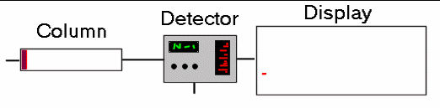
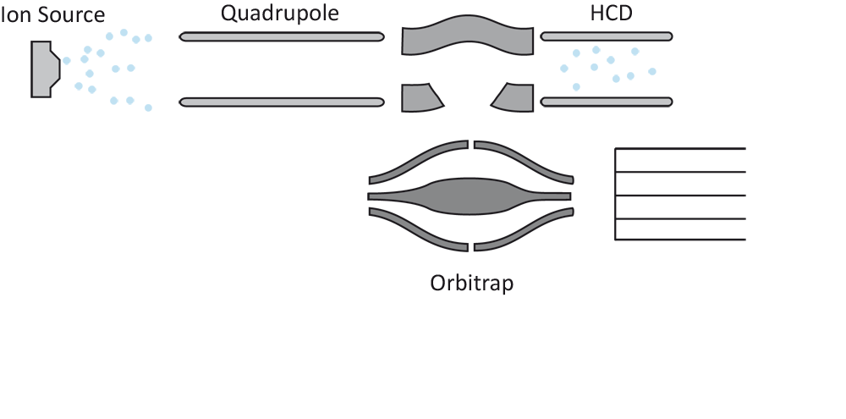

LC-MS/MS Data Structure

Slide 4
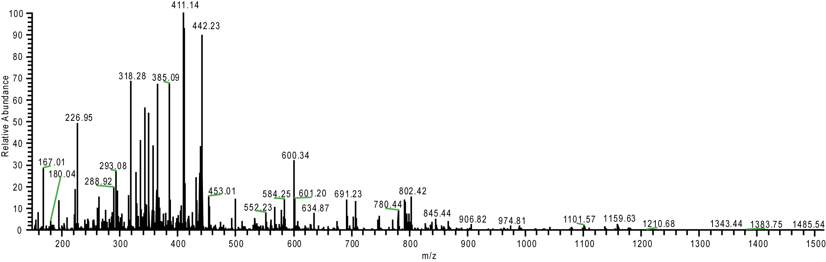
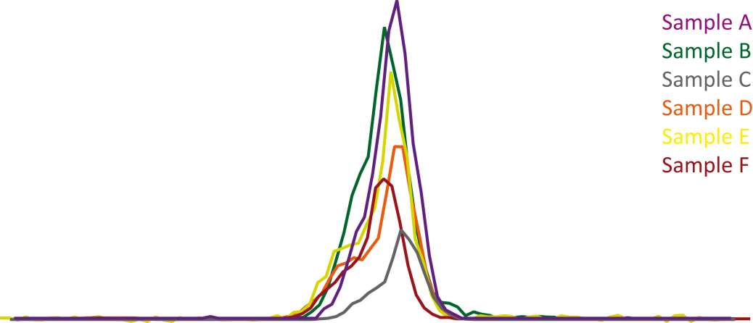
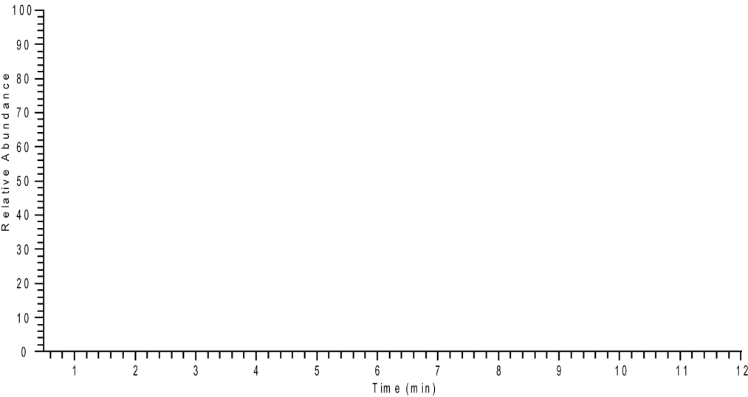

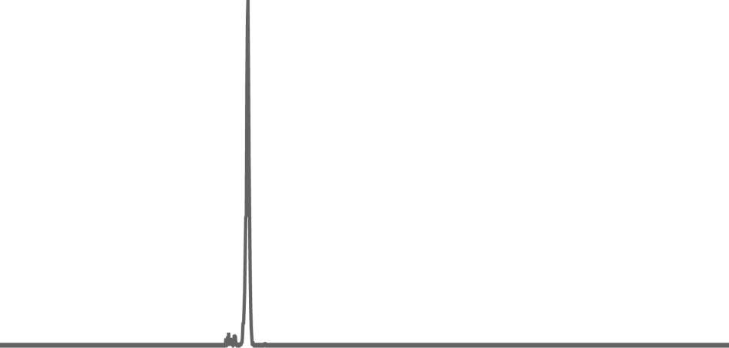

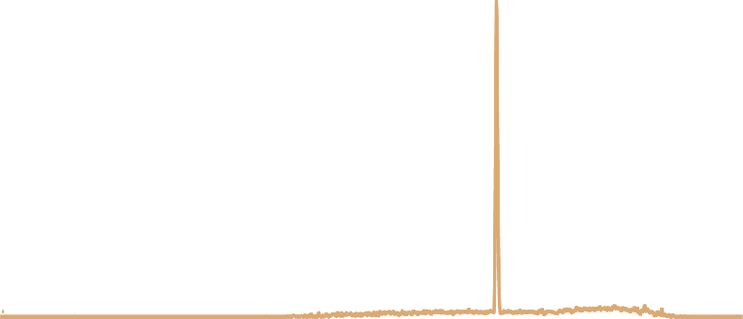

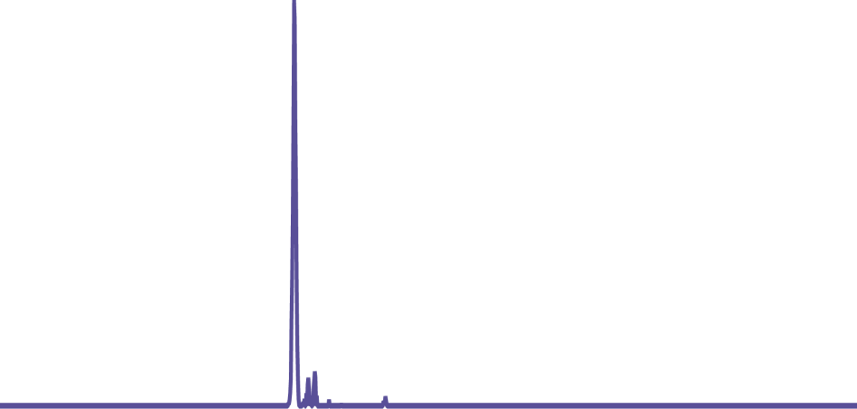



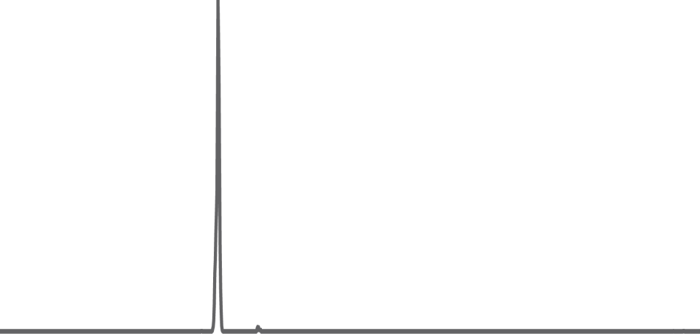
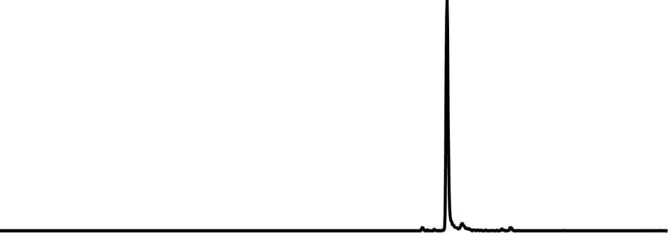
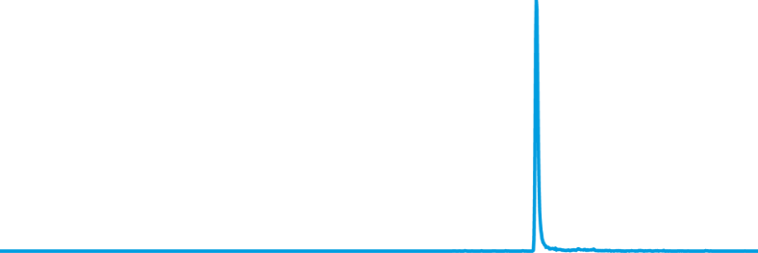

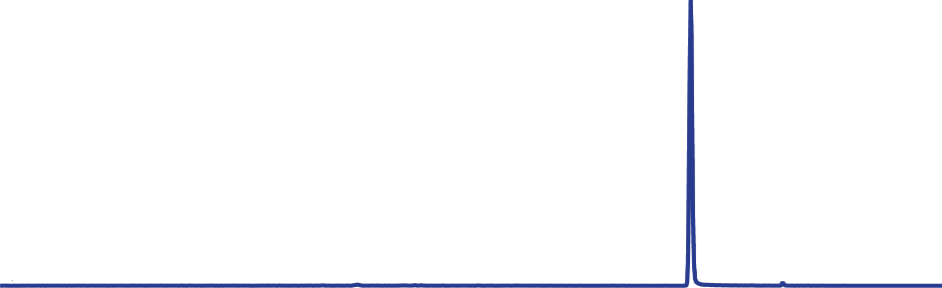
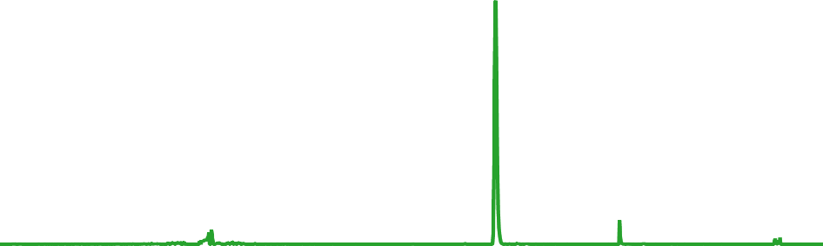





LC-MS/MS Data Structure
MS1
Aligned Chromatographic Peaks
Sample A
Sample B
Sample C
Sample D
Sample E
Sample F
XIC
MS/MS
Notes:
As you can see here at random MS1 scan from the chromatogram.
The the dataanalysis workflow we decided to use starts with MS1 feature extraction with Mzmine.
Here we pick high resolved exact masses and build extracted ion chromatograms in all samples. After this we align the XICs between different samples for relative quantitative comparison and within samples to identify different ion-adducts.
This not only reduces redundancy but allso increases confidence the molecular formual calcualation as this provides fixed atom number for example for Sodium Adducts.
However the Molecular formulas do not provide use structural informations.
Herefor we need to connect MS2 fragmentation data. And to connect this information the the MS1 data we actually had to dome up with a software solution which was realized by two computer science undergrads in our lab and is now available in the latest version of Mzmine.
Once we connect MS2 scan to our MS1 feature we search the fragment spectra against spectral libraries in order to annotated the molecules.

Slide 5
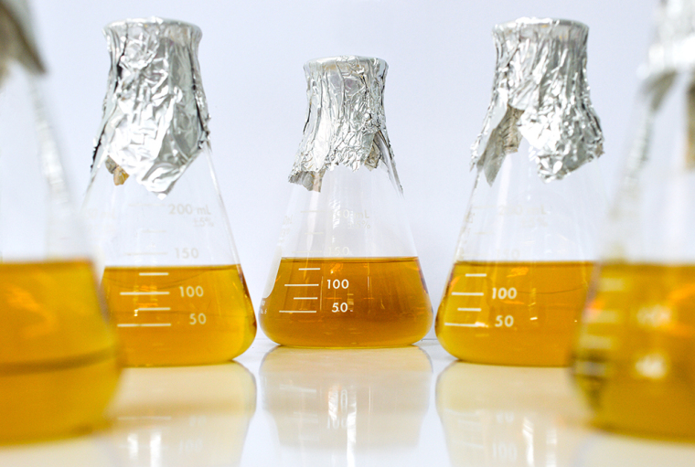
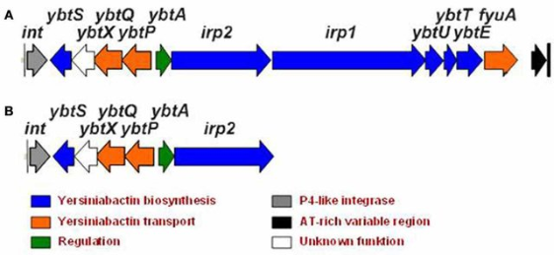
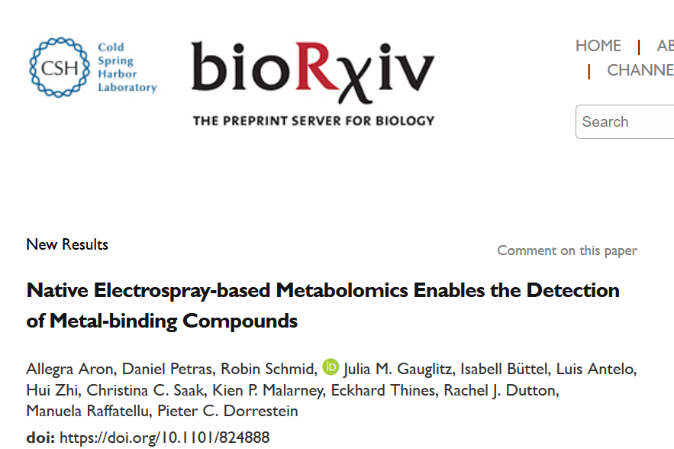
Hands on, step-by-step…
Can we find new siderophores produced by E. coli Nissle?

Slide 6
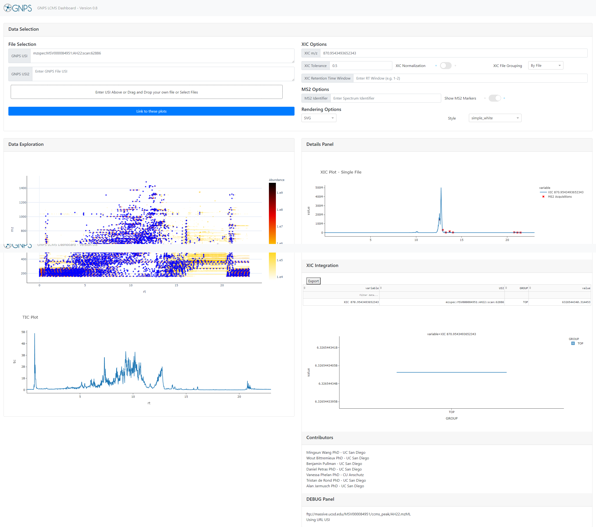

Interactively Exploring LCMS Data
Full LC/MS Mass Spec File
Visualize

Slide 7



Interactively Exploring LCMS Data
Visualize
Your Data in GNPS Jobs
Your Data to Upload
Public Metabolomics Data

Slide 8
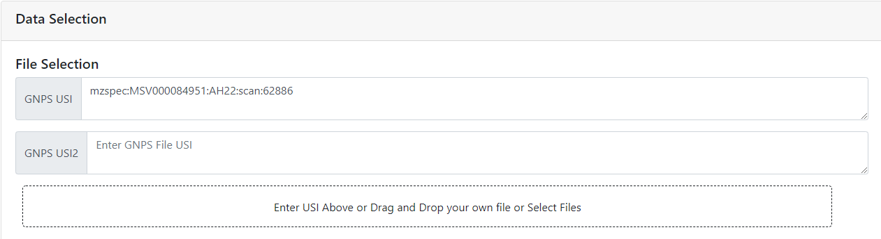
Selecting Data
Enter Universal
Spectrum Identifier
Identifiers Source
Your Data in GNPS Jobs
Public Metabolomics Data

Slide 9
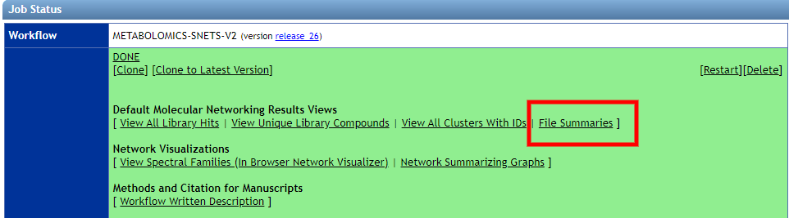
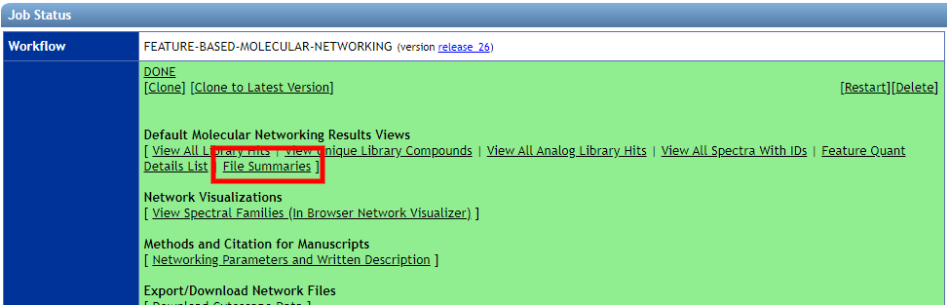
Selecting Data from GNPS Jobs
Classical Molecular Networking
Example Link
FBMN
Example Link

Slide 10
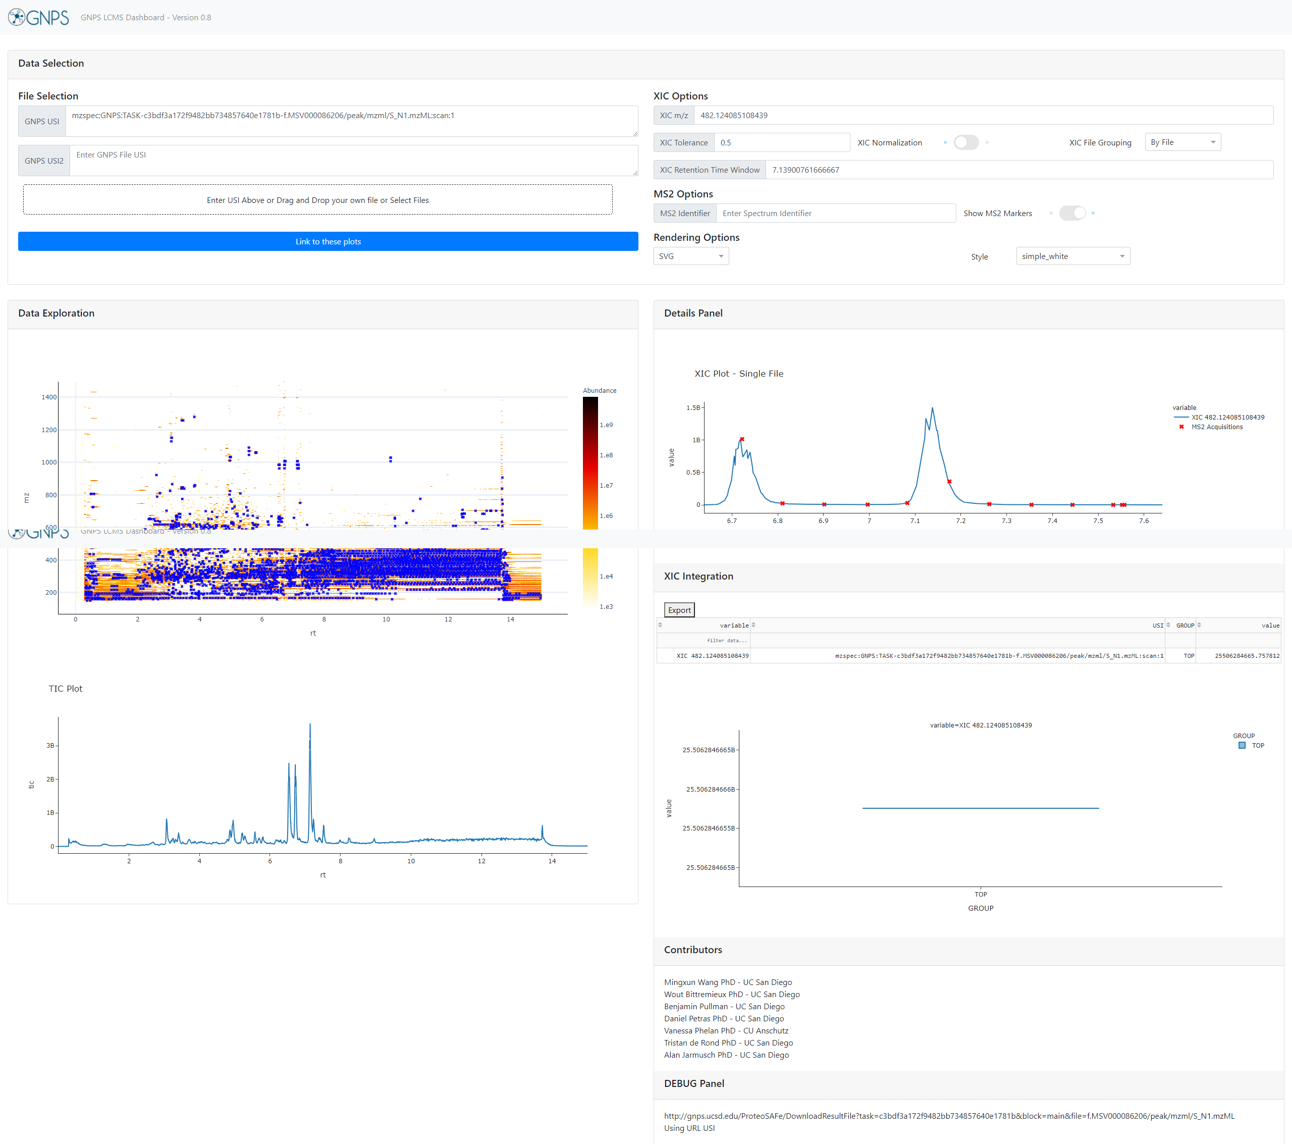
Visualizing in Interface
1.
2.
Data Selection
XIC Plotting Options
2D LCMS Heat Map
TIC Plot
XIC Plots/MS2 Plots
XIC Integration Results/Boxes
3.
5.
6.
4.
Example Link

Slide 11
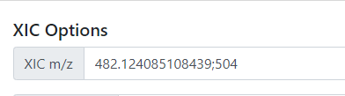
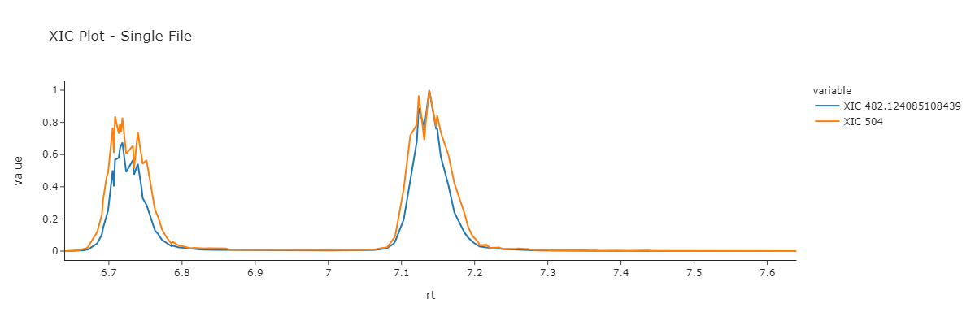
XIC on Multiple m/z
Example Link

Slide 12
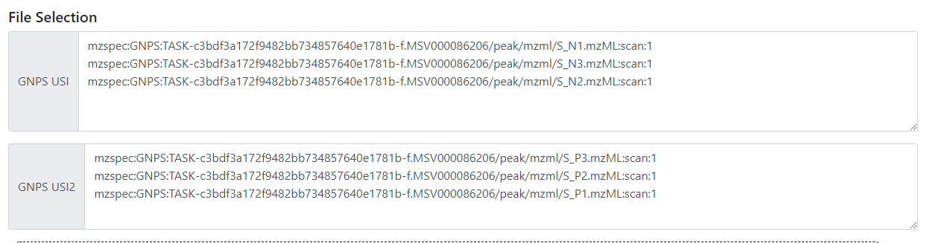
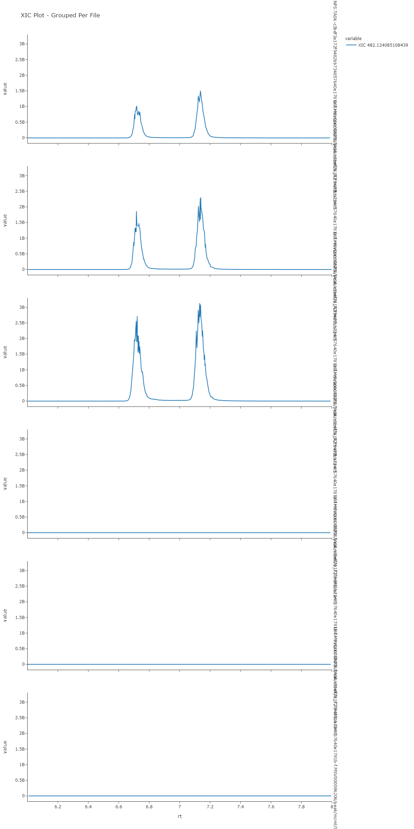
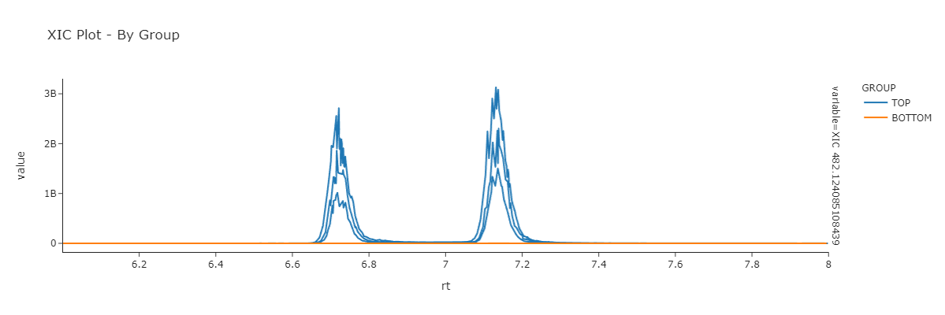
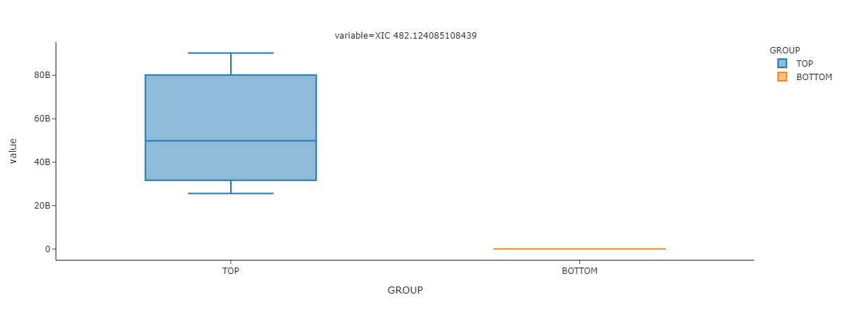
XIC Comparison on Multiple Files
Example Link

Slide 13
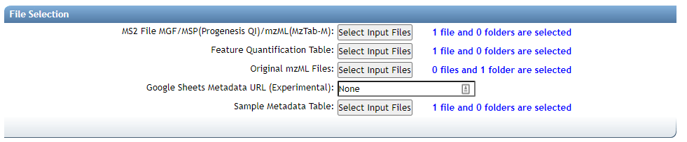
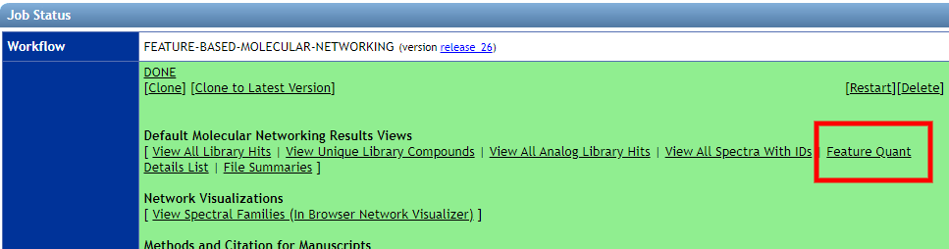
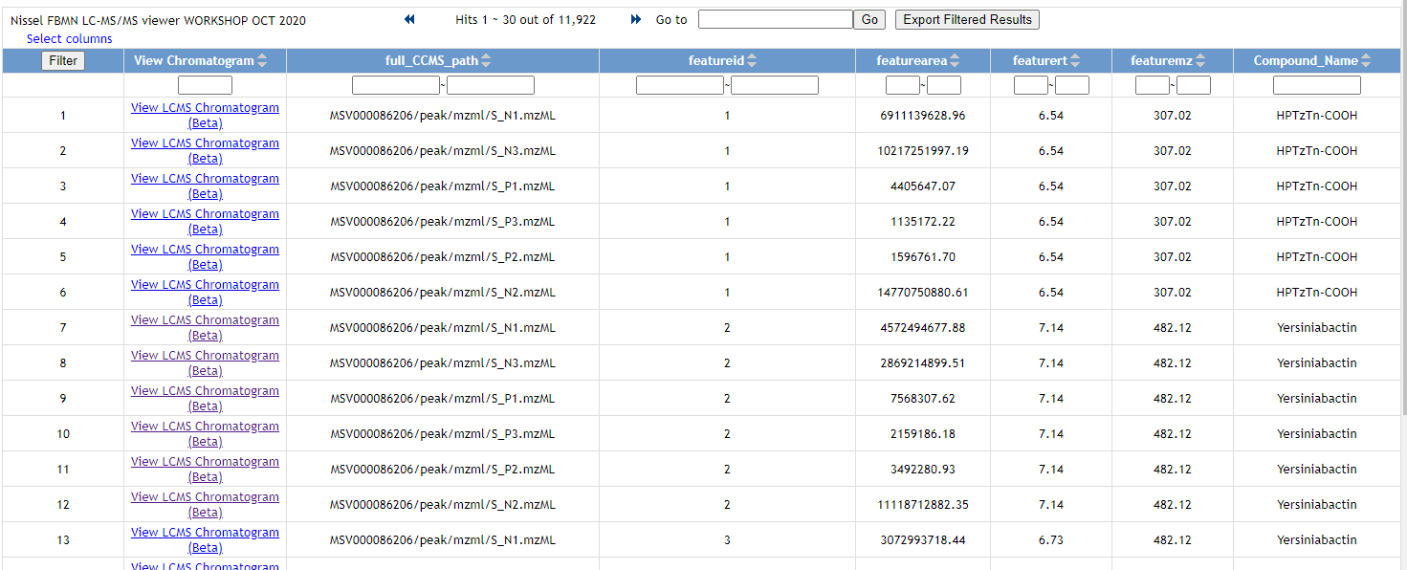
Inspecting Feature Finding Results from FBMN
Select All Original mzML Files
View Feature Quant Details List
Listing All Features across all files
Example Link

Slide 14
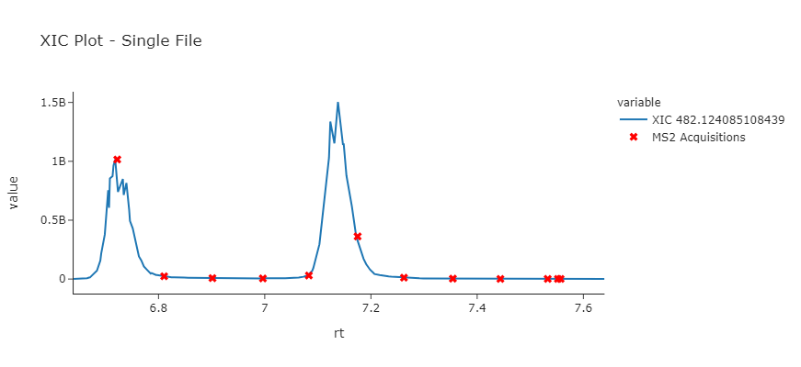
Inspecting Feature Finding Results from FBMN
Listing All Features across all files
Easily View Each Feature
Example Link

Slide 15
Questions, Problems or Bugs?
Documentation: https://ccms-ucsd.github.io/GNPSDocumentation/
Forum: https://groups.google.com/forum/#!forum/molecular_networking_bug_reports
PRESENTER NAMES AND EMAILS HERE

